Slide 1
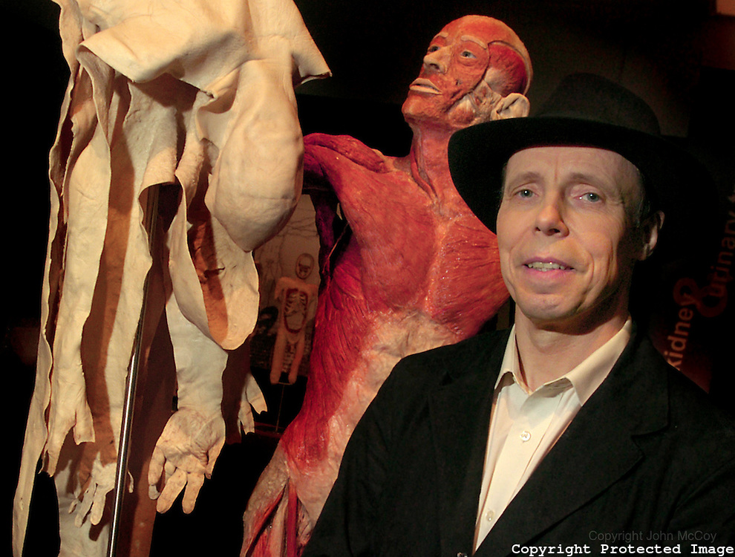
Chapter 5
The Integumentary System

Slide 2

INTRODUCTION
The skin and its accessory structures make up the integumentary system.
Functions to
Protect
Maintain body temperature
Provide sensory information about environment
What else?

Slide 3
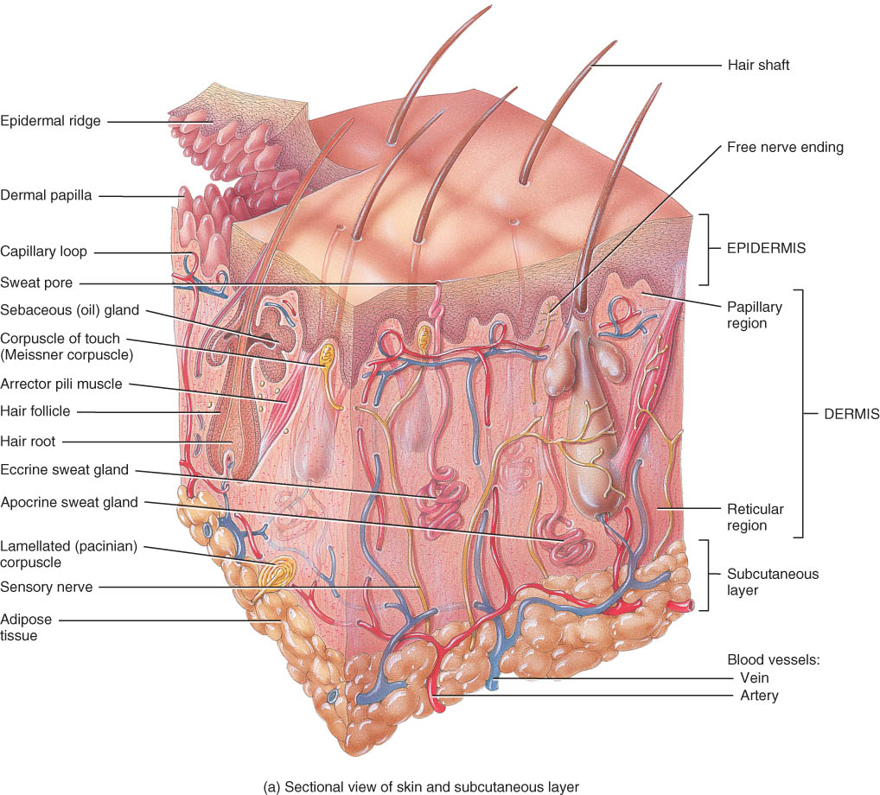
STRUCTURE OF THE SKIN
2 layers
epidermis
dermis
Subcutaneous layer or hypodermis. (not a part of the skin)

Slide 4
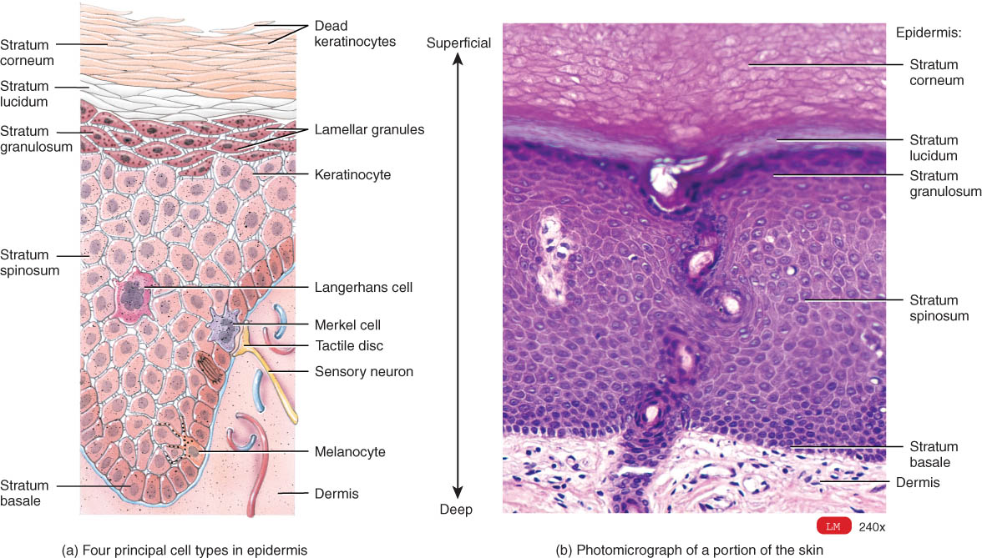
Overview of Epidermis
Stratified squamous epithelium
avascular (contains no blood vessels)
4 types of cells – info on next slide
4-5 distinct strata (layers) of cells

Slide 5
Four Principle Cells of the Epidermis –
keratinocytes produce the protein keratin, for protection
melanocytes produce melanin which contributes to skin color and absorbs damaging ultraviolet (UV) light
Langerhans cells
participate in immune response
Merkel cells
contact (Merkel) disc and function in the sensation of touch

Slide 6
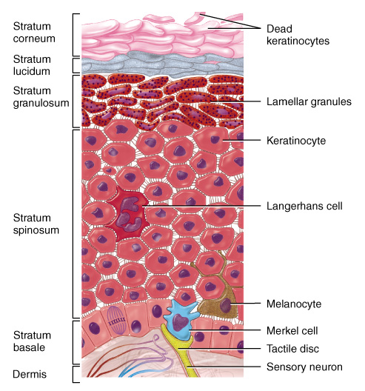
Layers (Strata) of the Epidermis
Stratum basale
Stratum spinosum
Stratum granulosum
Stratum lucidum
Stratum corneum

Slide 7
Stratum Basale (stratum germinativum)
merkel cells, melanocytes, keratinocytes & stem cells that divide repeatedly
Cells attached to one another by desmosomes & to the basement membrane by hemi-desmosomes

Slide 8
Stratum Spinosum
provides strength and flexibility to the skin
During slide preparation, cells shrink and appear spiny
Melanin from melanocytes is transferred to keratinocytes

Slide 9
Stratum Granulosum
Transition between living and dead cells
3-5 layers of flat cells
example of apoptosis
Contain lamellar granules that release lipid that repels water

Slide 10
Stratum Lucidum
Present only in the fingers tips, palms of the hands, and soles of the feet.
Three to five layers of clear, flat, dead cells

Slide 11
Stratum Corneum
25 to 30 layers of flat dead cells filled with keratin and surrounded by lipids
continuously shed

Slide 12
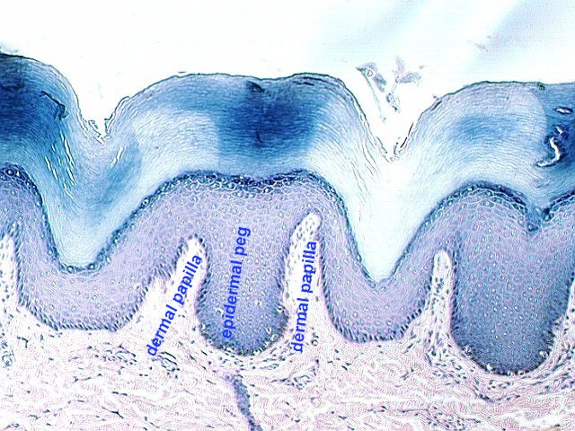
Epidermal Ridges
Produced during the 3rd month of fetal development
Increase the surface area of the epidermis and increase the grip of the hand or foot by increasing friction.
Increased surface area allows for more nutrient exchange from dermis
Increased surface area strengthens against shear forces

Slide 13
Dermis
Contains hair follicles, glands, nerves & blood vessels
Two major regions of dermis
papillary region
reticular region

Slide 14
Dermis - Papillary Region
Top 20% of dermis
areolar connective tissue
Finger like projections are called dermal papillae
anchors epidermis to dermis
contains capillaries that feed epidermis
contains Meissner’s corpuscles (touch) & free nerve endings for sensations of heat, cold, pain, tickle, and itch

Slide 15
Dermis - Reticular Region
Remaining 80%
Dense irregular connective tissue
Contains interlacing collagen and elastic fibers
Packed with oil glands, sweat gland ducts, fat & hair follicles
Provides strength, extensibility & elasticity to skin
stretch marks are dermal tears from extreme stretching

Slide 16
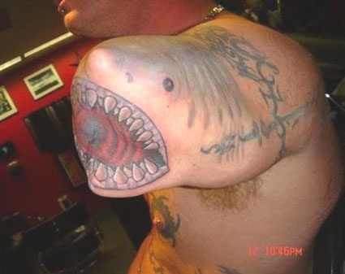
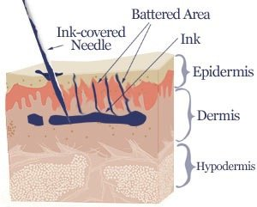
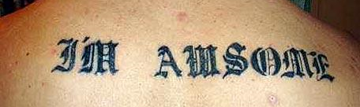
Tattoos
Tattooing is a permanent coloration of the skin in which a foreign pigment is injected into the dermis.

Slide 17
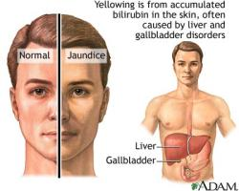
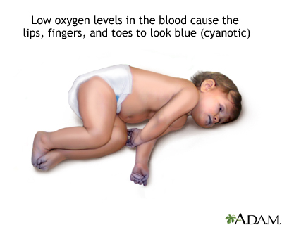
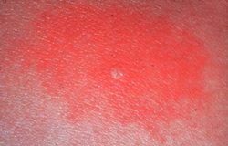
Skin Color Symptoms
Jaundice
yellowish color to skin and whites of eyes
buildup of yellow bilirubin in blood from liver disease
Cyanosis
bluish color to nail beds and skin
hemoglobin depleted of oxygen looks purple-blue
Erythema
redness of skin due to enlargement of capillaries in dermis
during inflammation, infection, allergy or burns

Slide 18
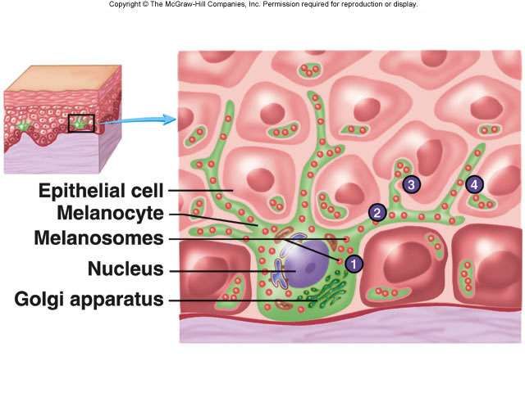
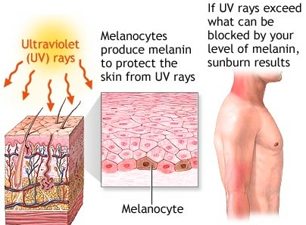
Skin Color Pigments
Melanin produced in epidermis by melanocytes
melanocytes convert tyrosine to melanin
UV in sunlight increases melanin production
same number of melanocytes in everyone, but differing amounts of pigment produced

Slide 19
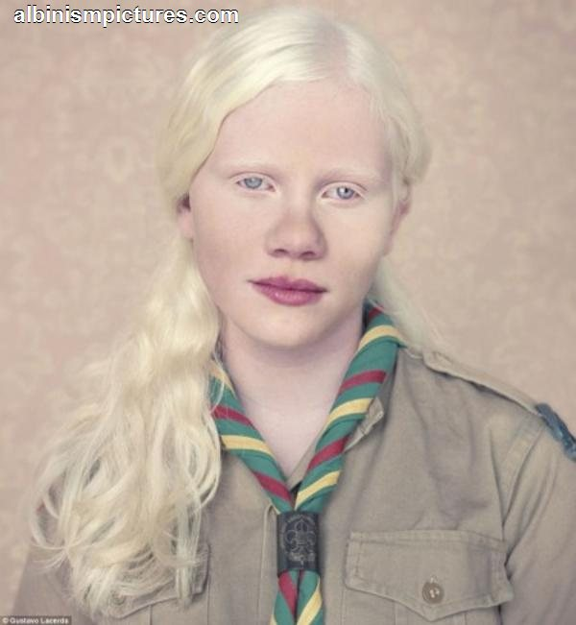
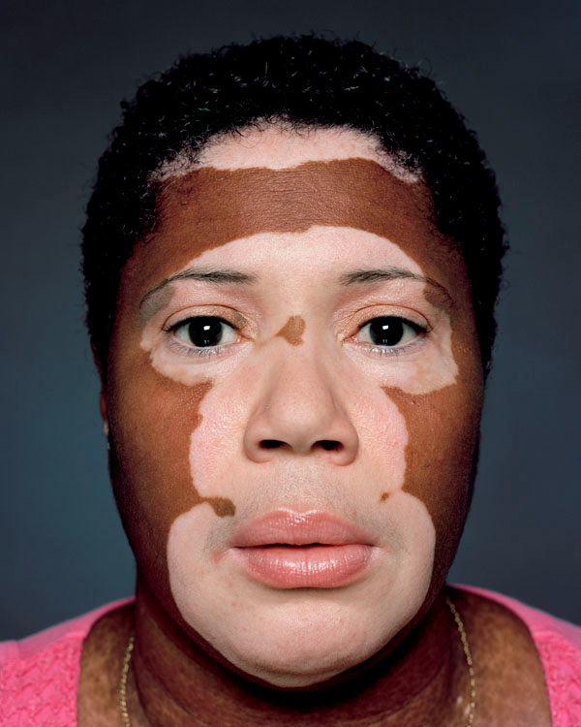
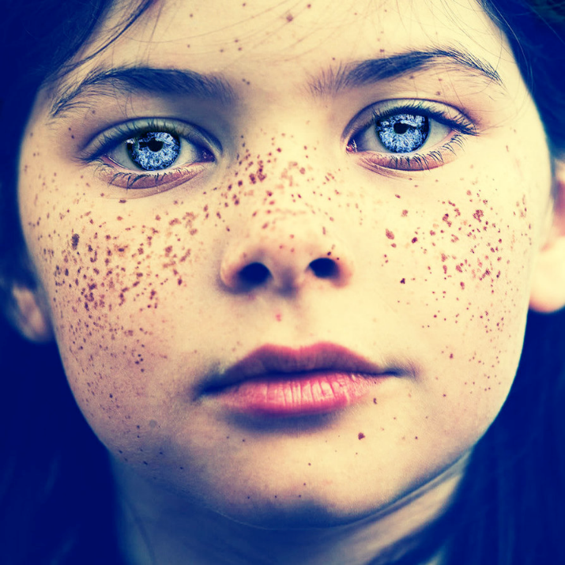
Skin Color Pigments
Clinical observations
freckles or liver spots = melanin in a patch
albinism = inherited lack of tyrosinase; no pigment
vitiligo = autoimmune loss of melanocytes in areas of the skin produces white patches

Slide 20
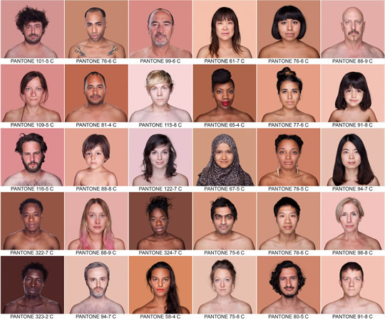
Why do we have different skin colors – the role of pigments
The wide variety of colors in skin is due to three pigments - melanin, carotene, and hemoglobin (in blood in capillaries) - in the dermis.

Slide 21
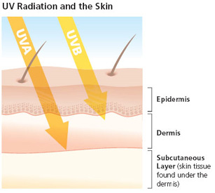
Why do we have different skin colors?
Two main selection pressures:
Protect folate from UVA
Important in:
Cell division (fetus and sperm cells)
DNA repair
Lack of can cause:
neural tube defects
Miscarriage
Various other complications during pregnancy
Make enough Vitamin D via UVB
Important in proper calcium absorption
Lack of can cause rickets

Slide 22
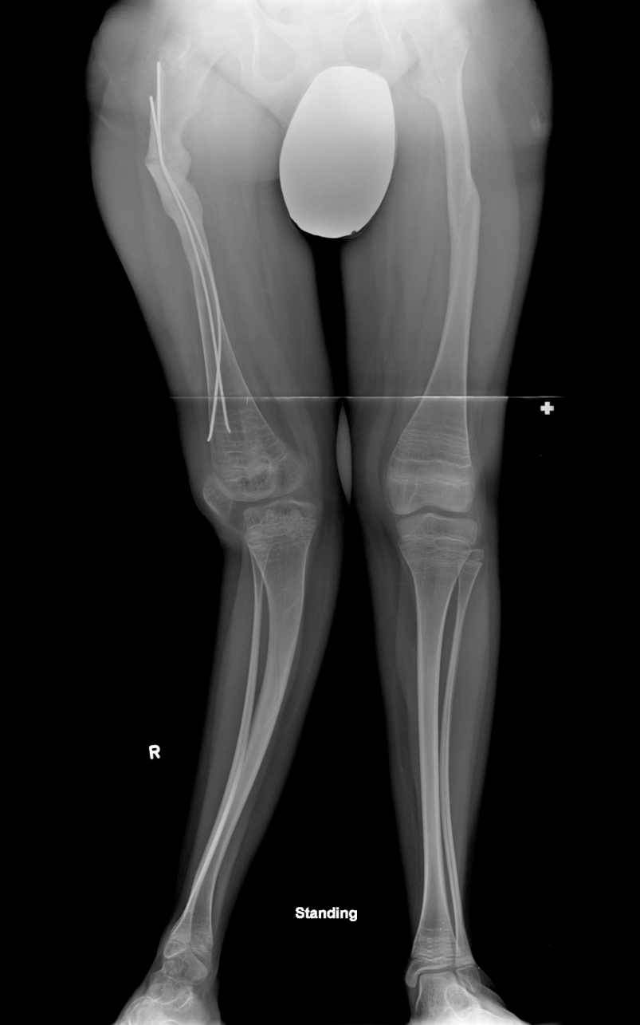
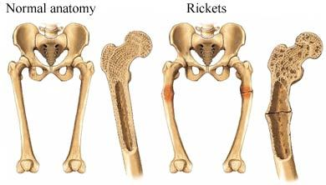
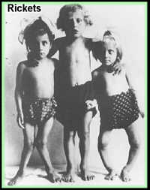
Rickets
Rickets is the softening and weakening of bones in children, usually because of an extreme and prolonged vitamin D deficiency

Slide 23
Accessory Structures of Skin

Slide 24
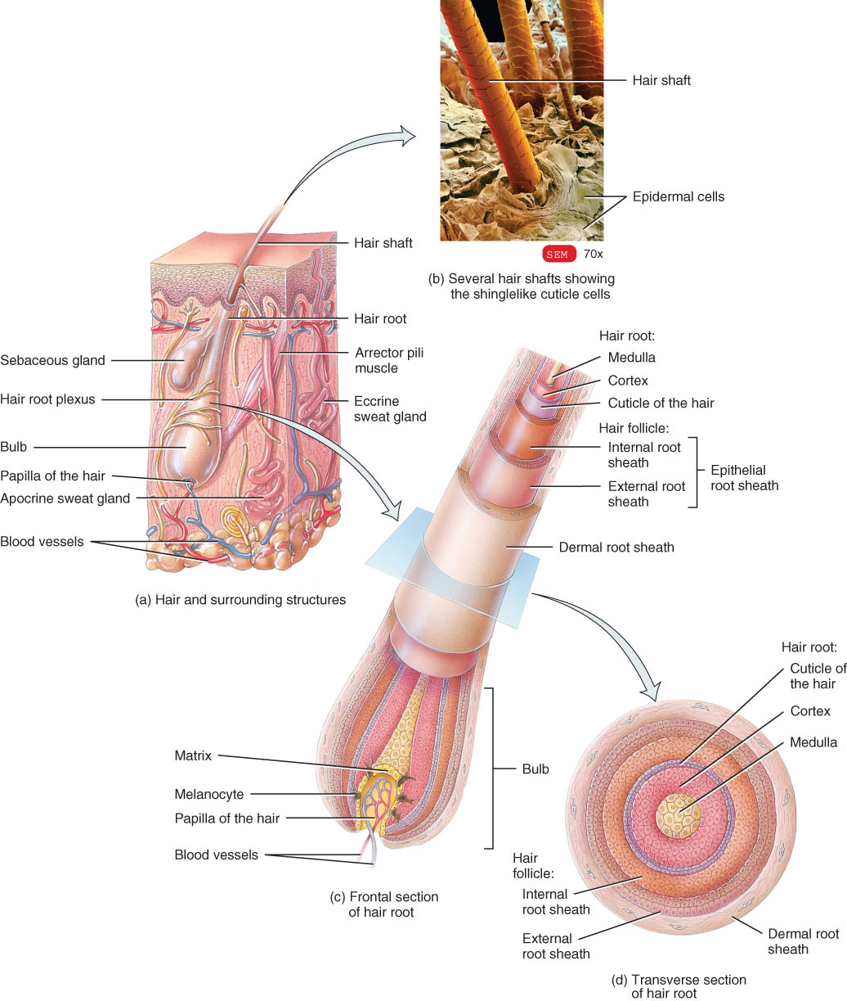
Structure of Hair
Shaft -- visible
medulla, cortex & cuticle
Root -- below the surface
Follicle surrounds root

Slide 25
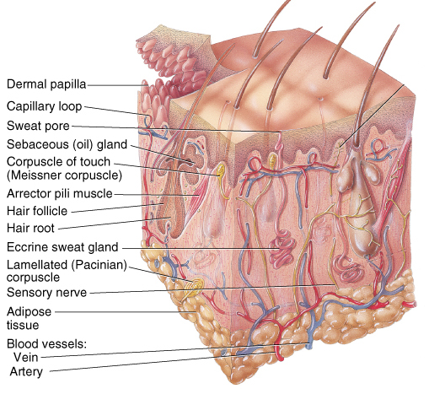
Hair Related Structures
Arrector pili
smooth muscle in dermis contracts with cold or fear.
Hair root plexus
detect hair movement
sebaceous (oil) glands

Slide 26
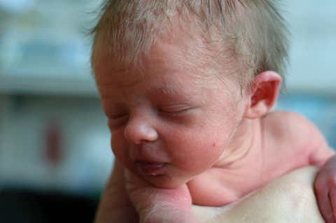
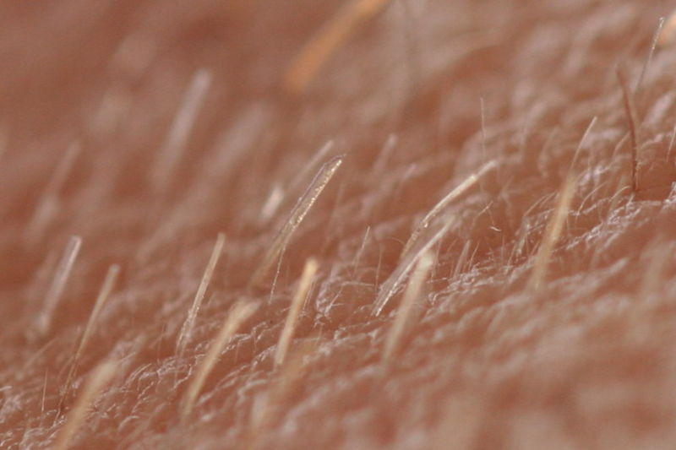
Types of hair
Lanugo is a fine, nonpigmented hair that covers the fetus.
Vellus hair is a short, fine hair that replaces lanugo
Terminal/course pigmented hair appears in response to androgens

Slide 27
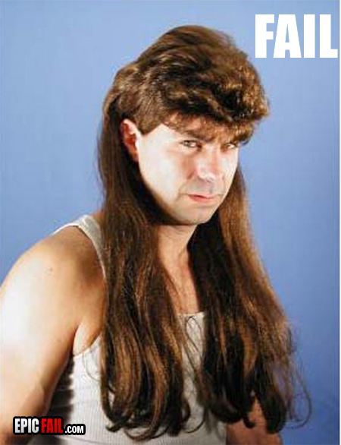
Hair Growth
The hair growth cycle consists of a growing stage and a resting stage.
Growth stage
lasts for 2 to 6 years
Resting stage
lasts for 3 months
matrix cells inactive & follicle atrophies
Old hair falls out as growth stage begins again
normal hair loss is 70 to 100 hairs per day
Hair length relates to length of growth stage

Slide 28
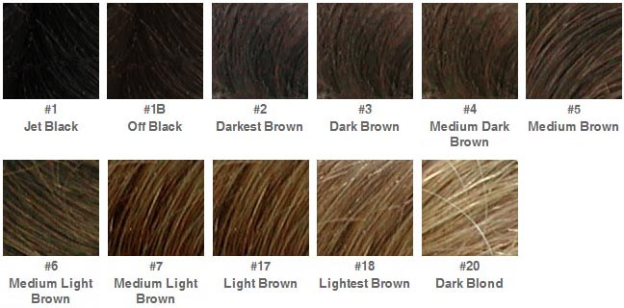
Hair Color
Hair color is due primarily to the amount and type of melanin.
Dark hair contains true melanin
Blond and red hair contain melanin with iron and sulfur added
Graying hair is result of decline in melanin production
White hair has air bubbles in the medullary shaft

Slide 29
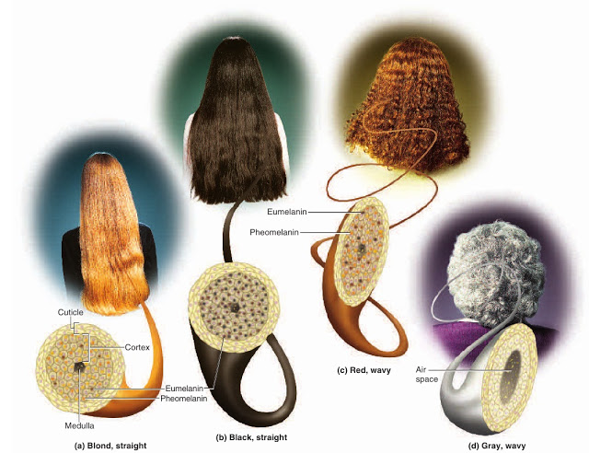
Hair body
Hair body comes from the shape of the hair follicle
Round – straight hair
Oval – wavy hair
Flattened – curly hair

Slide 30
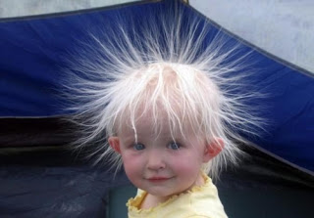
Functions of Hair
Prevents heat loss
Decreases sunburn
Eyelashes help protect eyes
Touch receptors (hair root plexus) senses light touch

Slide 31
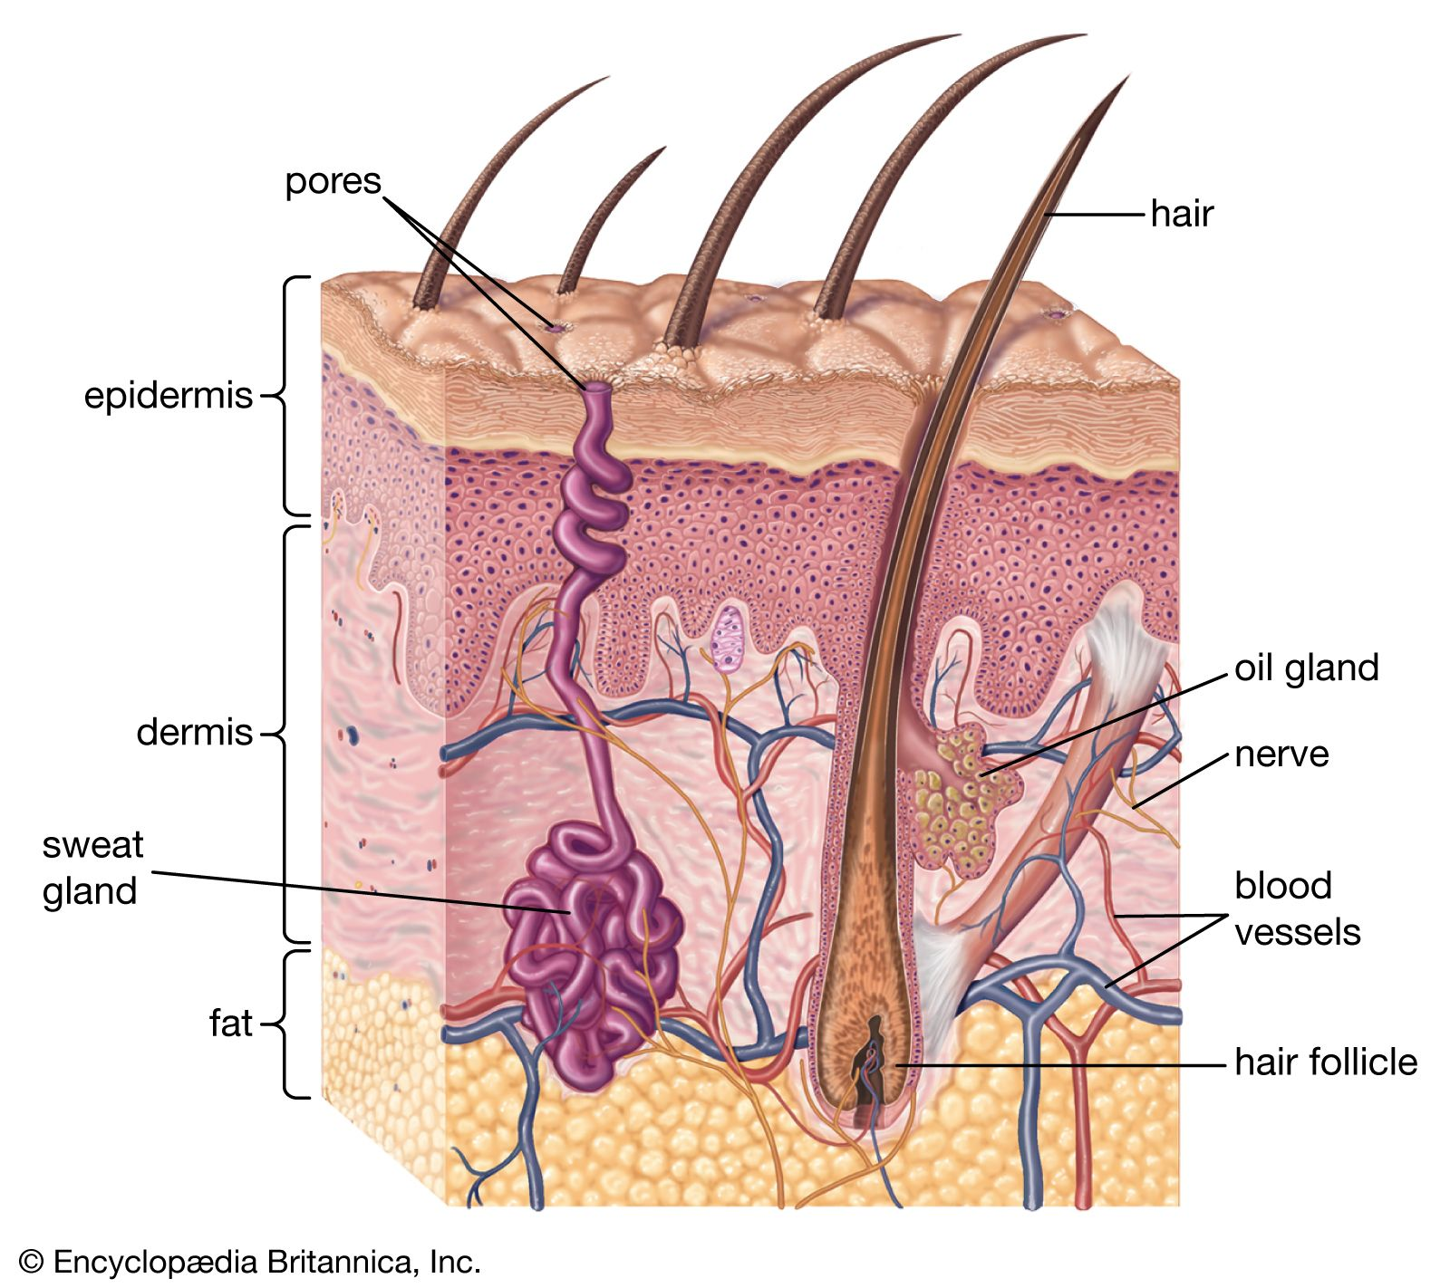


Skin Glands

Slide 32
Glands of the Skin
two main types:
Sebaceous (oil) glands
Sudoriferous (sweat) glands
Both glands originate in the epidermis and grow down into dermis/hypodermis.

Slide 33
Sudoriferous (sweat) glands
Eccrine sweat glands have an extensive distribution most areas of skin
ducts lead to skin surface
Secrete watery substance and wastes via ducts
Cool the skin
Apocrine sweat glands are limited in distribution to the skin of the axilla and pubis; their duct open into hair follicles.
secretions are milky and viscous (thick; not watery)
includes proteins that are ingested by bacteria

Slide 34
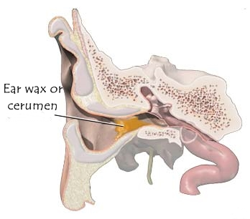
Ceruminous Glands
Ceruminous glands are modified sudoriferous glands that produce a waxy substance called cerumen (ear wax) in the ear canal.

Slide 35
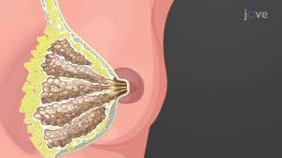
Mammary Glands
A special type of modified sudoriferous (sweat) gland.
Secretes milk
In females, this gland typically becomes functional during pregnancy, but it is also present in males.

Slide 36
Sebaceous (oil) glands
usually connected to hair follicles
produce sebum
contains cholesterol, proteins, fats & salts
moistens hairs
waterproofs and softens the skin
inhibits growth of bacteria & fungi
Acne
bacterial inflammation of glands
secretions are stimulated by hormones at puberty

Slide 37

What Can Go Wrong?

Slide 38
Photodamage
Ultraviolet light (UVA and UVB) both damage the skin
Acute overexposure causes sunburn
DNA damage in epidermal cells can lead to skin cancer
UVA produces oxygen free radicals that damage collagen and elastic fibers and lead to wrinkling of the skin

Slide 39
Burns
Generally, the systemic effects of a burn are a greater threat to life than are the local effects.
When the burn area exceeds 70%, over half of the victims die.

Slide 40
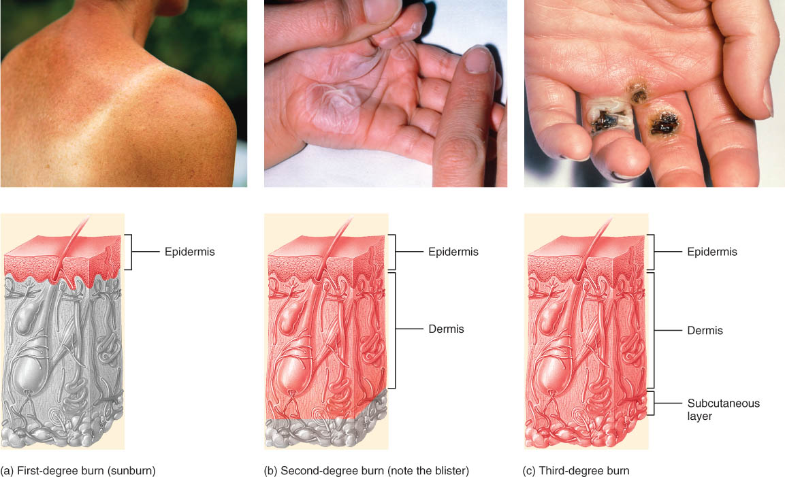
Burns First-degree burn
Affects: Epidermis only
What happens: Redness, pain, mild swelling, NO blisters
Example: Mild sunburn

Slide 41
Burns Second-degree burn
Affects: Epidermis + part of the dermis
What happens: Redness, blisters, swelling, may be painful
Example: Bad scald from hot water

Slide 42
Burns Third-degree burn
Affects: Epidermis + entire dermis (may extend into subcutaneous tissue)
What happens: Skin may look white, brown, or charred; little or no pain at first (nerves destroyed)
Example: Severe flame or chemical burn

Slide 43
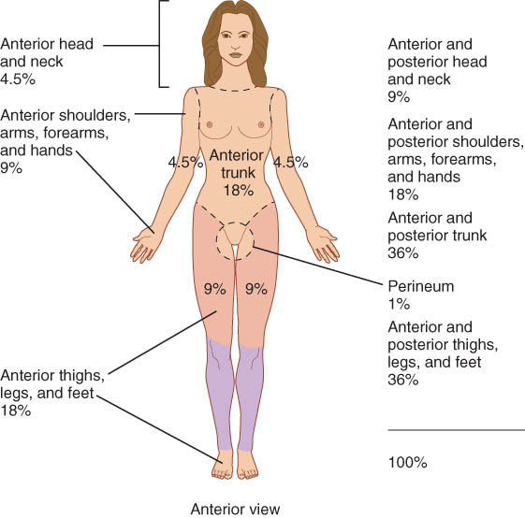
Burns – Rule of the 9s The Rule of Nines is a method used to estimate the total body surface area affected by burns in adults. It helps guide fluid resuscitation, treatment decisions, and burn severity.

